Slide 1
"Redemptive Leading" – Barriers and Opportunities in a Digital World
Matthias Scharer, Innsbruck

Slide 2
Rahner Archiv and Islamic Studies

Slide 3
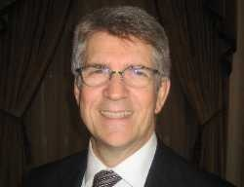
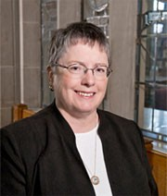
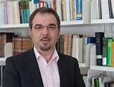
Notes:
My discipline is Practical Theology. I am one of the founders of "Communicative Theology" (CT). Around this, I am deeply connected with the Systematic Theologians Jochen Hilberath (Tübingen), Bradford Hinze (Fordham, New York), Mary Ann Hinsdale (Boston College), and many other theologians from various disciplines who are working together in our research circle. From the beginning, CT was meant to be ecumenical, and since 2008, we also have had Muslims joining our research community.

Slide 4
Religious/Theological Authority in a Digital World
Facilitating Interreligious Groups
Study on Leadership
Notes:
When I read the subject of this Conference "Religious/Theological Authority in a Digital World", two prospects came to mind:
- The first was my experience in facilitating interreligious groups in different parts of the world, especially in India. What does religious authority mean in this digitalized media context?
- The second was a reflection on a qualitative empirical study on leadership that I did with two colleagues on the responsible authorities in the diocese of Tyrol.
I decided to focus on the second one because the first one was too hot for me: In January 2015 in Bangalore, I was sent back to Austria by the Indian Immigration Authorities on the same flight I had arrived on.
So, what I want to do here is, to re-read our research on leadership from the perspective of the subject of this conference. Our research was published in the book "Redemptive Leadership", edited by Johannes Panhofer, a pastoral theologian, Roman Siebenrock, a systematic theologian and myself.

Slide 5
1. Preliminaries
Notes:
1. Preliminaries
You know that German speakers like preliminaries. So I will give two: Let me make clear what "Redemptive Leadership" means and how we understand our empirical research-method based on CT.

Slide 6
1.1. Redemptive Leadership
Notes:
1.1. Redemptive Leadership
With the title "Redemptive Leadership," we are highlighting that leadership in the perspective of CT is not simply finding building skills which can be gotten from leadership concepts just anywhere. Leadership skills and concepts are not neutral. They include specific worldviews and philosophies. If you manage a parish or diocese like you would manage a big factory, you would introduce aspects of the neoliberal economic system and its world view in ecclesiastical contexts. In this sense, leadership of a parish or diocese need a theological reflection on their relevance or irrelevance being a sign of the upcoming Kingdom of God. "Redemptive Leadership" can be understood as a metaphor to the theological relevance of every leadership concept, especially when it comes to the question of Authority.

Slide 7
1.2. Empirical Research in CT
4 D I M E N S I O N S
3 L E V E L S
Level of Scientific Reflection
Level of Experience and Interpretation
Level of Involvement and Participation
Notes:
1.2. Empirical Research in CT
The second preliminary remark is related to the method of empirical research in CT.
Some of you will remember this graph. As you can see here, CT is working on three levels with four factors on each level. The levels of encounter and experience are so close together with the level of research that you can't separate them. Also, the factor of I, the We and the Globe is deeply connected with the subject of the research project. Like you do in Grounded Theory, Action Research, and some other similar empirical methods you understand yourself not as a distanced researcher who has to research on an object. You deeply respect the others who are partners in the research program. You welcome them as "experts in praxis" on the same level as we are "experts in theory". It does not mean that the two expert views are separated. They are, in fact, close together. They are two aspects of the same insight.
These research requirements hinder us from doing quantitative research on anonymous. We could see how this kind of research, which we are doing, influences the research partners in our study of leadership: We editors wanted to summarize and anonymise the texts we got from our partners, however; they protested against our proposal and wanted to come out in the book with their original texts and with their name. At a two day conference, the "experts in theory" such as colleges from Bible Studies, Systematic Theology, Church Law, Systematic and Practical Theology met the "experts in praxis". It was very impressive to see how the insights of the "experts in praxis" changed the concepts of the researchers on the meaning of leadership and authority in church and religion.

Slide 8
2. The Partners in our Research and Some Key Questions
Notes:
The openness of the "experts in praxis" makes me free to introduce them with a photo.

Slide 9
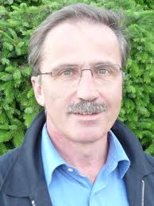
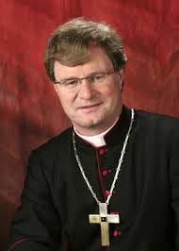
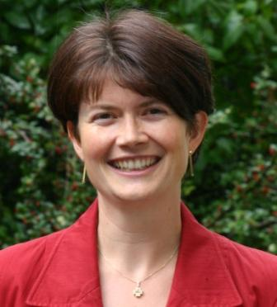
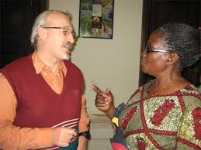
Worldwide Church
Responsible for/in Diocese
Hans Eigner
Comboni-Missionar
Manfred Scheuer
Bischof von Innsbruck
Elisabeth Rathgeb
Seelsorgeamtsleiterin in Innsbruck
Hans Humer, Pfarrer in Tanzania
Notes:
2. The partners in our research and some key questions
As you can see on the slides, all relevant Authorities of the Diocese were included in the research. The 23 testimonies of understanding leadership came out from all sectors of pastoral work:
- It starts with the bishop and the woman responsible for personal and pastoral care. - We took a view into the worldwide church.

Slide 10
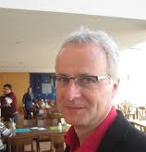
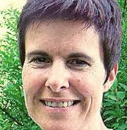
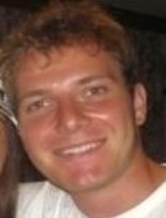
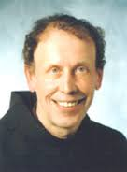
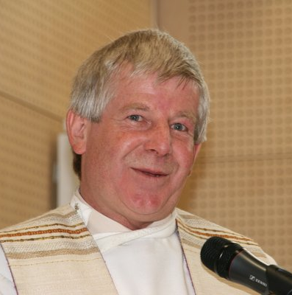
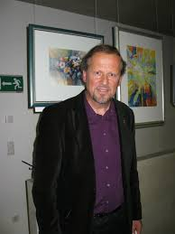
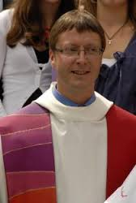
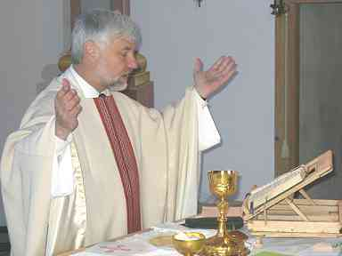
Responsible for/in Parishes
Monika Fiechter-Alber
Pfarrgemeinderatsobfrau in Neu-Rum
Clemens Haider
Jungschargruppenleiter
Raimund Kreidl
Pfarrer und Pfarrmoderator
Raimund Eberharter
Pfarrkurator
Franz Neuner
Dekan in Breitenwang
Herbert Traxl
Pfarrer in Untermieming und Barwies
Franz Troyer
Pfarrer in Innsbruck-Allerheiligen
Otto Walch, Pfarrer und Leiter des Pfarrverbandes Unteres Lechtal
Notes:
- It goes on to parish pastoral in which priests and lay people have leading positions.

Slide 11
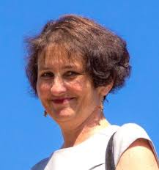
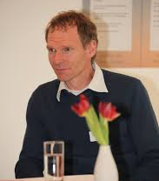
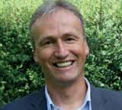
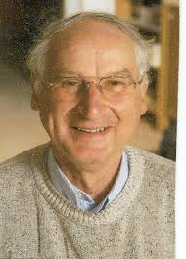
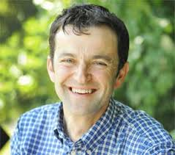
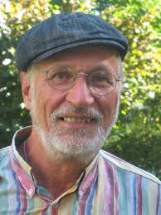
Responsible in Caritas/Diaconie
Astrid Höpperger
Leiterin der Telefonseelsorge Innsbruck
Martin Lesky
Bereichsleiter f. Regional- und Freiwilligenarbeit in der Caritas IBK
Werner Mühlböck
Leiter Welthaus Innsbruck
Alois Rauch
Diakon in Roppen
Christian Sint
Gemeinschaftsverantwortlicher
der „Arche Tirol“
Jussuf Windischer
Leiter Caritas-Integrationshaus
Notes:
- After this comes the domain of Caritas and Diaconie.

Slide 12
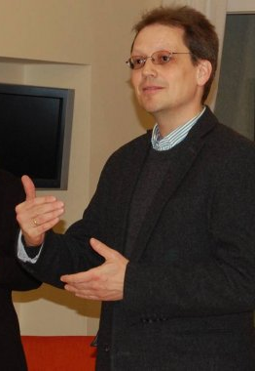
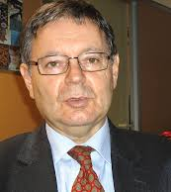
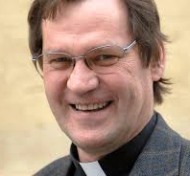
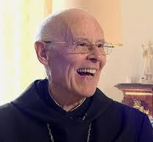
Responsible in School and Education
Peter Paul Steinringer
Direktor des Realgymnasiums der Ursulinen in Innsbruck
Peter Ferner
Regens und Pfarrmoderator
Siegfried Springsguth
Leiter d. Bildungshauses St. Michael, Matrei a.Br.
Superiors in Monastries
One died !!!
Wolfgang Thienen
Guardian im Kapuzinerkloster Innsbruck
Anselm Zeller
OSB und Abt von Stift Fiecht
Notes:
School and education follow.
We also asked the Superiors in monasteries.

Slide 13
Questions
What is the leading metaphor for your understanding of leading?
In what context is your leading experience and how does this context influence your understanding and practicing of leading?
Where and when do you encounter yourself most intensively as a leader (please give examples)?
Where do you most experience your passion for leading and where do you most experience your burden of leading?
Where are typical conflict areas and borders of your leadership?
What are the (spiritual, theological, practical....) resources in your leadership?
What future prospects do you see in your own leadership and in that of the church?
What for me is important in the future?
Notes:
We gave some questions to the "experts in praxis". These should not be a stationary grind but an open proposal to describe theirs understanding of leadership. For some it was helpful; others neglected our proposal.
Proposal Questions were:
- What is the leading metaphor for your understanding of leading?
- In what context is your leading experience and how does this context influence your understanding and practicing of leading?
- Where and when do you encounter yourself most intensively as a leader (please give examples)?
- Where do you most experience your passion for leading and where do you most experience your burden of leading?
- Where are typical conflict areas and borders of your leadership?
- What are the (spiritual, theological, practical....) resources in your leadership?
- What future prospects do you see in your own leadership and in that of the church?
- What for me is important in the future?

Slide 14
3. Re-reading our Study in the Perspective of "Religious/Theological Authority in a Digital World."
Notes:
3. Re-reading our study in the perspective of "Religious/Theological Authority in a Digital World."
Before I point out some specific statements, I will shortly reflect on the relationship between leadership and religious/theological authority in a Digital World in general. Within this, I am relating to the concept of Participatory Leadership as a possible mode to deal with Authority in a specific way.

Slide 15
3.1. Authority between Ministry, Leadership, Power and Role
Notes:
3.1. Authority between ministry, leadership, power and role
The relationship between authority and leadership is apparent. It depends on every leading situation, especially in churches and religions. Here authority and leadership mostly are connected with special powers legitimized at last by the transcendence.
The higher the role in the hierarchy is, the more powered authority is connected with the role of leadership. Particularly in information- and communication-based societies, with its flat or nonexisting hierarchies, powerful authorization in specific roles like we have in the Catholic Hierarchy seems archaic.

Slide 16
Niclas Luhmann‘s System Theory
The power of roles is apparent.
A system is viewable by the communication of decisions that are made by the decision makers.
Instead of seeing the person in that role, see them as an individual.
Religions are characterized by the decision-making authorities operating in their specific roles.
Notes:
But if we have a look at the "System Theory" of Niclas Luhmann, which is already used in church connections like parish counseling, the power of roles is apparent. Luhmann argues that a system is viewable by the communication of decisions that are made by the decision makers, instead of seeing the person in that role as an individual. For Luhmann, Religions are a specific kind of system, which are characterized by the decision-making authorities operating in their specific roles.
See: LUHMANN, Niklas: Funktion der Religion, Frankfurt am Main: Suhrkamp ^{1. Aufl., [Nachdr.]}2004; LUHMANN, Niklas/ KIESERLING, André: Macht im System, Berlin: Suhrkamp ^{Erste Auflage}2012.

Slide 17
Irritating Leadership of Pope Francis?
"The Roman Pontifex obtains full and supreme power in the Church by his acceptance of legitimate election together with episcopal consecration. Therefore, a person elected to the supreme pontificate who is marked with episcopal character obtains this power from the moment of acceptance." (Can 332)
Notes:
In the way of the leadership of Pope Francis, we can see how someone who represents in his role the highest authority, power and leadership in the Catholic Church irritates the System especially of the Vatican administration. Does Pope Francis represent the traditional role of the pope how we read it in Christus Dominus, Art. 2 or Canon 332? The authentic and communicative leadership of Pope Francis, in which some commenters see the real power of this pope, show us how ambivalent the connection of ministry, authority, power and leadership is. This ambivalence rises enormously in a Digital World.

Slide 18
3.2. Participatory Leadership – a way to deal with authority and power in Churches and Religions?
Specific characteristics:
leading in front of
leading for
leading within (participatory)
Notes:
3.2. Participatory leadership - a way to deal with authority and power in Churches and Religions?
In our book we differentiate three kinds of leadership. They are not totally separated from each other; however they do have specific characteristics:
leading in front of
leading for
leading within
See: HILBERATH, Bernd Jochen/ SCHARER, Matthias/ HASLINGER, Herbert: Konkretion: Leitung, in: HASLINGER, Herbert(Hg.): Handbuch Praktische Theologie 2, Mainz: Matthias-Grünewald-Verl. 2000 (= Handbuch praktische Theologie / hrsg. von Herbert Haslinger ... Bd. 2), 494–510.

Slide 19
Leading in front of…
Authorised
Leader
Digilized World as
Globe
Clear messages
from authorised
Authority
disciplined community
people
people
people
people
people
people
people
people
Notes:
In Churches and Religions, leadership is sometimes used as a kind of "leading in front of the people". One has the power, authority and competence to speak authentically; the others are in the role to obtain, to believe and at the best to ask. Apart from liturgy this kind of leadership is rarely in our research.

Slide 20
Leading for...
Empathic messages from authorised
Authority
in Solidarity with the waekest
harmonious community
participant
participant
participant
empathic, aware, sensitive leader
participant
participant
participant
Digilized World as
Globe
participant
participant
Notes:
The most frequently mentioned type of leadership is “leading for”. This style became familiar after the Second Vaticanum, especially in Pastoral Contexts of the Catholic Church. "Leading for" seems to be fully sympathetic to all the people. Leaders will do everything for the people. They help them to grow up and live well. What problem should exist with this leading style? As you can see on the graph, all depends on the charity and sensitivity of the leader. Participants can't grow for themselves under this style of leadership. If the leader goes away, there would be no responsibility within the people.

Slide 21
Leading within (participatory)
chair person
Self-contained and
mainfold community
chair person
chair person
Good News
thematized
in relation
to I, We, within the (digilized) World
Leader
chair person
chair person
chair person
chair person
Notes:
Connected to Theme-Centred-Interaction (TCI) of Ruth C. Cohn, in CT we know and use a participatory leadership. I experienced examples of this type of leadership in Communidades Christianas in Peru and Brasil. Participatory (or participative) leadership is a style of leadership that involves everyone in identifying essential goals and developing procedures to reach those goals. It also means that he/she is a part of the whole group and cannot take up a position on the outside of the group.
One of the main benefits of participatory leadership is that the process allows for the development of additional leaders who can serve the organization at a later date. Because leaders who favor this style encourage active involvement on the part of everyone on the team, people often are able to express their creativity and demonstrate abilities and talents that would not be made apparent otherwise. The discovery of these hidden assets help to benefit the work of the current team, but also alerts the organization to people within the team who should be provided with opportunities to further develop some skill or ability for future use. Real “leading within” is rarely something we encounter in our study. Mostly you can find this type of leadership in leading small groups within a parish or within the diozese.

Slide 22
3.3. The participatory leadership of ecclesiastical and Religion authorities in a Digital World: Where are the risks and where are the opportunities?
(Selective) authentic messages
from the Authority and from
Other Chairpersons
chair person
Self-contained and
mainfold community
chair person
chair person
Good News
thematized
in relation
to I, We, within the (digilized) World
Leader
chair person
chair person
chair person
chair person
Digilized World as
Globe
Notes:
What might it mean if ecclesiastical authorities were to adopt the principles of Participative Leadership in a Digital World?
3.3. The participatory leadership of ecclesiastical and Religion authorities in a Digital World: Where are the risks and where are the opportunities?
Participatory leadership is closely connected with the authenticity of leaders and participants. For Ruth Cohn selective authenticity of "chairpersons" is one of the main fruits of participatory leadership. Everyone should come to her/his chairperson. Participatory leadership is also familiar with disturbances and passionate involvements. Participatory leaders are not the big bosses or the untouchable masters. They appear with very touchable and vulnerable faces; also with some fragilities that a leader normally may not show.
As long as you try this in small Christian Communities it seems to be no problem, and people become responsible for the Community. In a publicity-seeking Digital World in which every weakness of a leader is communicated very quickly and few people are ready to take responsibility without transferring it to authorities, it seems to be very risky to live a participatory leadership outside of small groups. It would seem that it would be the biggest risk for P. Francis that he seems to do in some cases as the Leader of the universal Catholic Church.
If I am right, P. Francis respects that this kind of leadership does not primarily come from effort or special skills, rather it comes out of a deep theological conviction that the truth of Christianity manifests itself in practicing it. To practice redemptive leading in the role of the pope is the self-evident consequence of such a theological position.
As dangerous as an authentic and participatory leadership may be, we can also see a big desire for it, especially the credibility of Churches and Religions seems to depend on it. Whether it is Pope Francis, or the Dalai Lama or other authentic leaders within and authentic leaders outside of Religions for example Mandela, for many people they are symbols of hope. In the "Inauguration-homily" of Pope Francis, which took place on the feast of St. Joseph, in view of 136 political leaders and the most leaders of Churches and Religions, P. Francis got in line with the protectors of mankind. In the Enzyclical Letter “Laudato si” Pope Francis writes: “In my Apostolic Exhortation Evangelii Gaudium, I wrote to all the members of the Church with the aim of encouraging ongoing missionary renewal. In this Encyclical, I would like to enter into dialogue with all people about our common home.“ In both Enzyclicas Pope Francis shows himself as an affected, invested man with emotions, not as a cool, observing outsider who speaks above.

Slide 23
3.4. The awareness on "Religious/Theological Authority in a Digital World": Conscious within the leading persons of the Diocese of Innsbruck
Notes:
3.4. The awareness on "Religious/Theological Authority in a Digital World": Conscious within the leading persons of the Diocese of Innsbruck
Coming back to the re-reading of our qualitative study regarding leadership, the awareness of the “experts in praxis” on "Authority in a Digital World" is very poor, but this is also a result. Analyzing the texts we have to consider that nearly all lay people, except one priest working in Kenya, mention authority in the context of leadership. Some of the lay people like the pastoral worker or the leader of Crisis Intervention see a lack of authority qua office. The leader of Integration-house mentions the kind of Pre-Vaticanum authority qua office, which hindered the trust in the church and hindered a lot of chances, especially in youth work. The Comboni Missionary from Kenya reflects upon the natural authority that Missionaries already have in this country.
Instead of Authority the question on power is very virulent in the texts of the "experts in praxis". It starts with the bishop who sees himself swaying between the acceptance of conflict of the people and using his power to say "a definitive word." Some Catholics are looking for this. The person responsible for pastoral and personal care (she is theologian and historian) articulates the big problem of clerical claim to power in history and sometimes nowadays with a lack of objectivity and authenticity. She mentions that power in the Church is not power coming out from itself; it is derived power - ultimately from the Transcendence. One of the ministers mentions the powerful persons in the parish, without one of them you can't do anything. Another priest mentions the ambivalence of powerful leadership because only power based in love is a legitimate power in Church. Another aspect especially mentioned from some priests and one leader of a Convent is to empower and authorize people in the parish.
Only the bishop sees the problem that the "Laws of Media" are characterizing "language, symbols, spaces, times, and leadership".

Slide 24
4. Conclusion
Authority in Churches/Religions is deeply connected with the style of Leadership.
To differentiate styles of leadership (leading in front of, leading for and leading within) is helpful; all three styles are represented in the study on leadership in the Diocese of Innsbruck.
“Redemptive Leadership” highlights the theological impact of every leading practice of authorities.
Participatory leadership corresponds with "redemptive leadership". It is a big risk in a Digital World, and it evokes a great desire as we can see in leaders within and outside of Churches and Religions.
Notes:
4. Conclusion
- Authority in Churches and Religions is deeply connected with the kind of leadership which Leaders are practicing.
- A differentiation between "leading in front of", "leading for" and "leading with" can help us to differentiate styles of leadership within Churches and Religions. All three styles are represented in the study on leadership in the Diocese of Innsbruck.
- To speak about "redemptive leadership" highlights the theological impact of every leading practice of authorities.
- Practicing a participatory leadership, as a kind of "leading with", is deeply connected with (selective) authenticity; it is aware of the precedence of resistance and deep involvements.
- Participatory leadership corresponds with "redemptive leadership". It is a big risk in a Digital World, and it evokes a great desire for the benefits of participatory leadership, as we can see in leaders within and outside of Churches and Religions.
- In re-reading the qualitative empirical study that was done on the understanding of leadership in the Diocese Innsbruck, we can see a lack of awareness on "Religious/theological Authority in a Digital World" and its implications.

